Slide 1
BACKGROUND: The SRA’s new approach to continuing competence

Slide 2
Timeline
October 2011: Outcomes Focused Regulation
February 2014: SRA publishes consultation paper "Training for Tomorrow"
May 2014: SRA announces new approach to CPD
February 2015: 2015 LSB approves proposal
April 2015: Transition period begins
November 2016: Full implementation

Slide 3
Current scheme
You can choose to remain with the current CPD scheme until 31 October 2016
The requirement is to complete 16 hours of CPD annually
It is no longer necessary to attend accredited courses as part of the requirement

Slide 4
New scheme
You can choose to adopt the new approach for the current CPD year ending October 2015
You can choose to adopt for the next CPD year: Nov 2015-October 2016
The new approach is mandatory for the November 2016-October 2017 year

Slide 5
'Tick-box' to competency
Principle 5: You must provide a proper standard of service to your clients
2.9 You should provide a proper standard of client care and of work. This would include exercising competence, skill and diligence, and taking into account the individual needs and circumstances of each client.

Slide 6
'Tick-box' to competency
2.10 For a solicitor, meeting the competencies set out in the Competence Statement forms an integral part of the requirement to provide a proper standard of service.

Slide 7
Competence Statement
www.sra.org.uk/competence
The SRA has confirmed the competency statements can be edited to reflect the language that is used in-house. You are not restricted to the exact wording in the handbook

Slide 8
Responsibly is shifting from the individual to the law firm
"It is increasingly the case that responsibility for professional development lies with the entity for which the individual works." * (SRA consultation 14 May 2014
"With the growing role of non-lawyers within regulated entities, our focus must shift towards the entity to ensure competent services are provided to consumers and the public."

Slide 9
Why change
Arbitrary number of hours CPD each year is no guarantee of competence
Wrong sort of learning and development behaviour – focus on compliance rather than competence
Blanket approach
New approaches to learning and development

Slide 10
How do you move to the new scheme
You do not need to inform the SRA that you are moving to the new approach
There is no cutoff date. you can decide to move to the new approach right up until 31 October 2016

Slide 11
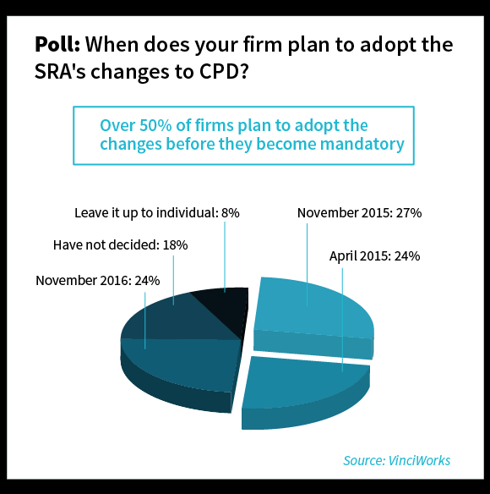
How many firms are moving

Slide 12
SRA Training Regulations 2011 Part 3
Regulation 3: "You must... consider and undertake the learning and development you deem necessary to ensure your ongoing competence and that you are in a position to provide a proper standard of service to your clients"
Guidance note: "The SRA Competence Statement for solicitors sets out what we mean by ongoing competence"

Slide 13
SRA’s guidance - recording hours is not enough
Reflect on your practice to identify your learning and development needs
Plan how you will address your learning and development needs
Address you learning and development needs
Record and evaluate your learning and development activity

Slide 14
How to reflect
What are my strengths and weaknesses?
Could I have done that better? If so, what? (And how?)
Was it to do with knowledge, technical skills or 'soft' skills / behaviours? If so, what knowledge, skills or behaviours were lacking?
In relation to that knowledge, or those skills or behaviours, how would I describe where I am now compared to where I need to be?
What do I need to do to get to where I need to be?

Slide 15
How to plan
What you need to do
Why you need to it
When you need to do it
How you will do it
Prioritising your learning and development needs

Slide 16
How to plan
What do I want/need to learn? | What will I do to achieve this? | What resources or support will I need? | What will my success criteria be? | Target dates for review and completion

Slide 17
Example
"Keep up to date with the latest legal, procedural and practice developments by:
reviewing daily and weekly email updates on an ongoing basis
attending monthly team meetings to discuss developments
attending the 'Legal Update' training sessions delivered by [ ] twice a year"

Slide 18
How to learn
Formal training
Shared learning
'Informal' training
Research, reading and discussion
Monthly update meetings
File reviews
Networking
Mentoring
Social media

Slide 19
How to record
SRA does not prescribe a specific approach, however, for each of your identified learning and development need(s) you may find it useful to record:
what you did;
how it was related to ensuring your competence;
what you learnt;
when the activity was completed.

Slide 20
How to record
Key dates | What did you do? | Why? | What did you learn from this? | How have/will you use this? Any further action?

Slide 21
Annual Declaration
“I have reflected on my practice and addressed any identified learning and development needs.”
The declaration is made on the Practising Certificate Renewal Exercise (PCRE) forms. Either individual solicitors, or entities who complete the PCRE in bulk, can make the declaration.

Slide 22
Annual Declaration
“The regulatory obligation for solicitors is that they must comply with principle 5. Any declaration will be related to that obligation and to the steps solicitors take to ensure they comply with it.
Solicitors who move to the new approach will be required to reflect on the standard of their work by reference to the Competence Statement for solicitors and to address identified learning needs. Solicitors who do this will be in a position to make any necessary declaration.”

Slide 23
The VinciWorks system for continuing competence

Slide 24
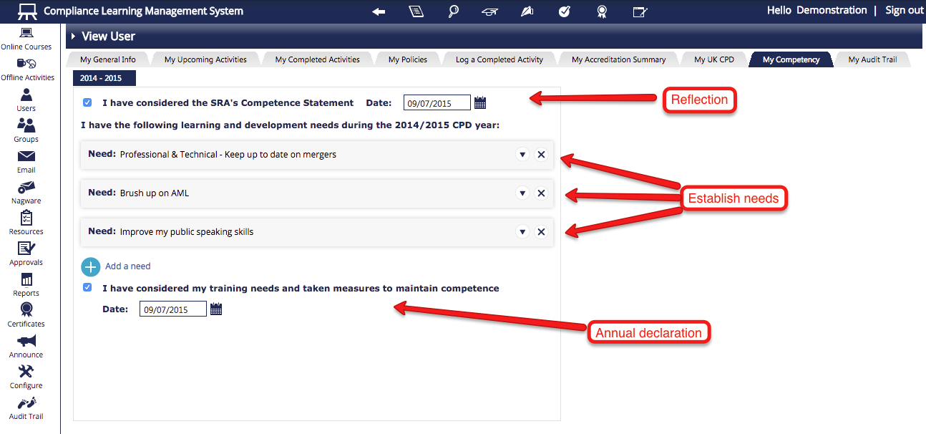

Slide 25
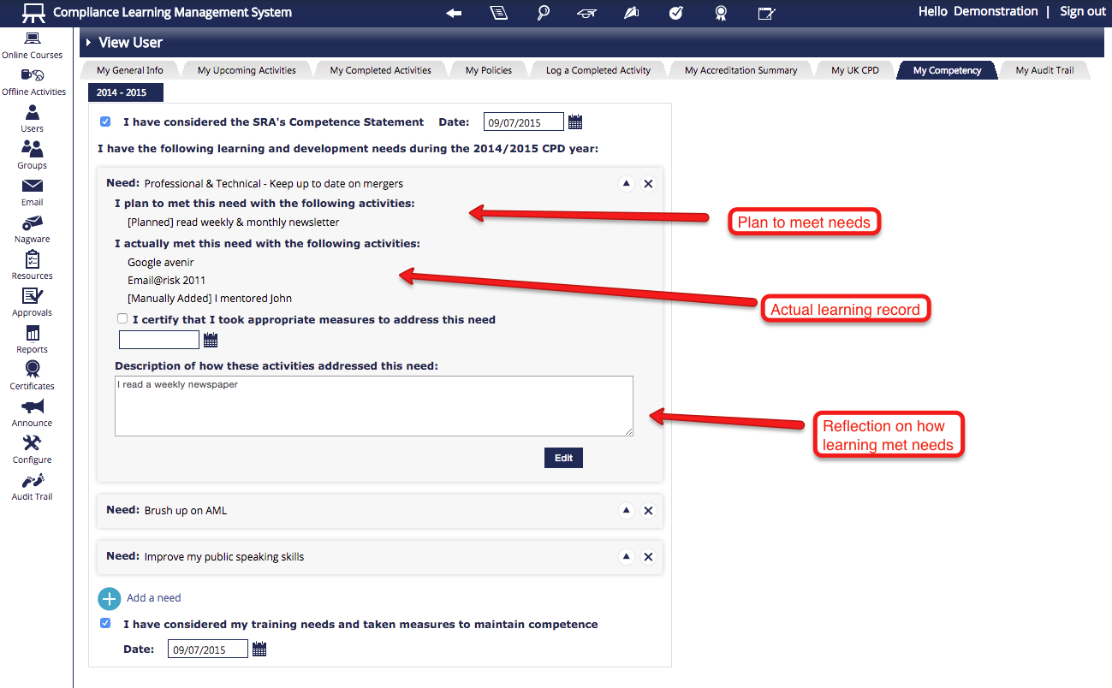

Slide 26
Reporting

Slide 27
A short introduction to

Slide 28
Leading provider of risk and compliance solutions
60 of the top 100 law firms in the UK
1 in 5 UK solicitors currently use VinciWorks

Slide 29
Leading provider of risk and compliance solutions
85,256 active users
7,400 monthly e-learning course completions

Slide 30
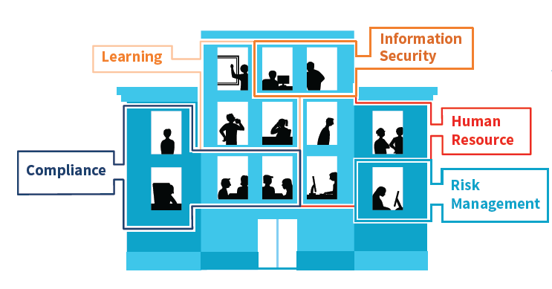
Solutions across the organisation

Slide 31
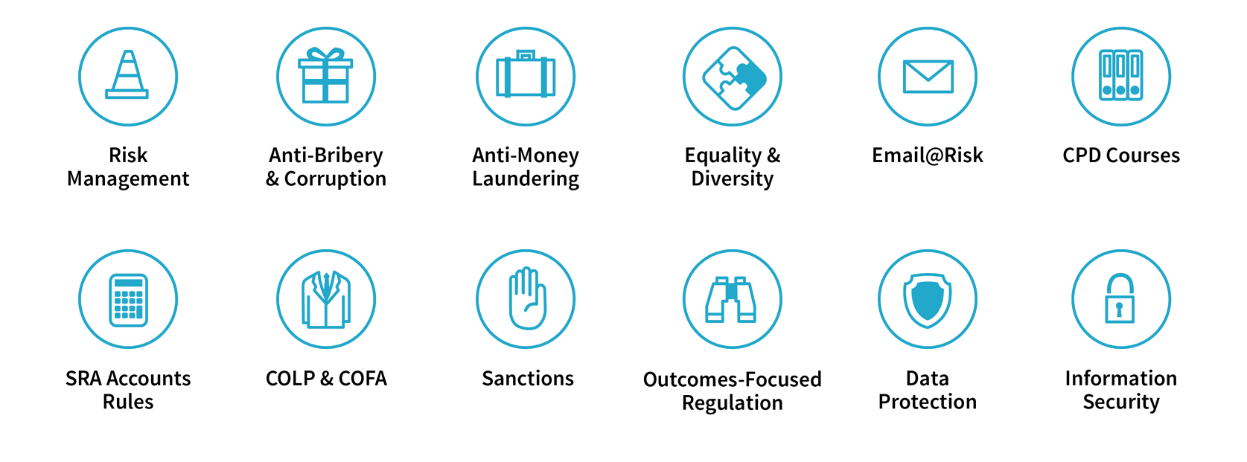
Online Compliance Courses

Slide 32
Compliance Learning Management System (CLMS)

Slide 33
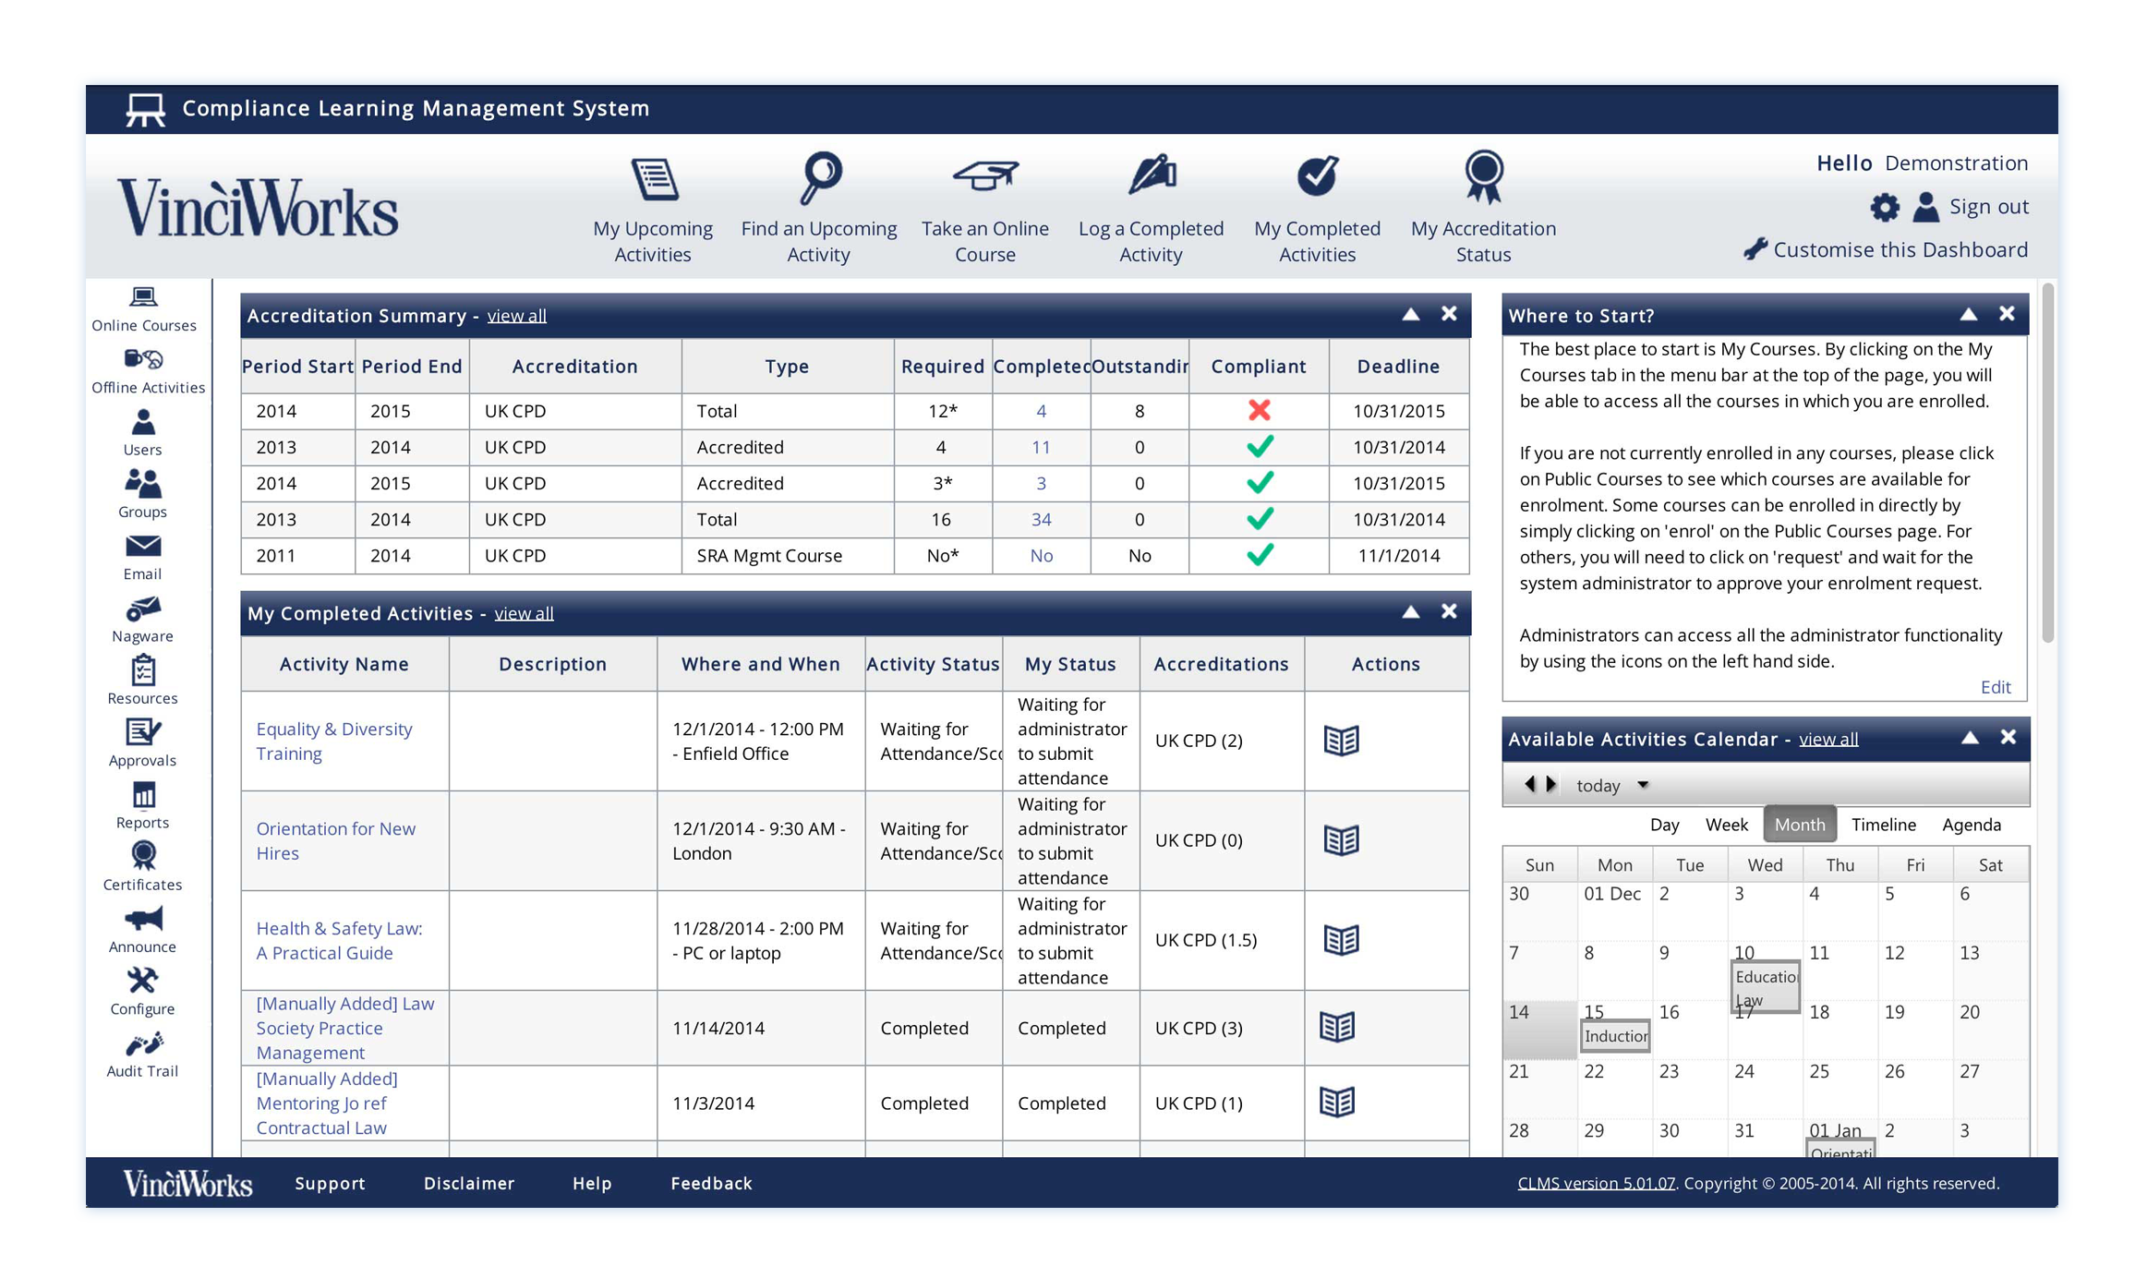
Compliance Learning Management System
Notes:
Example of a dashboard
- Flexible, modular

Slide 34
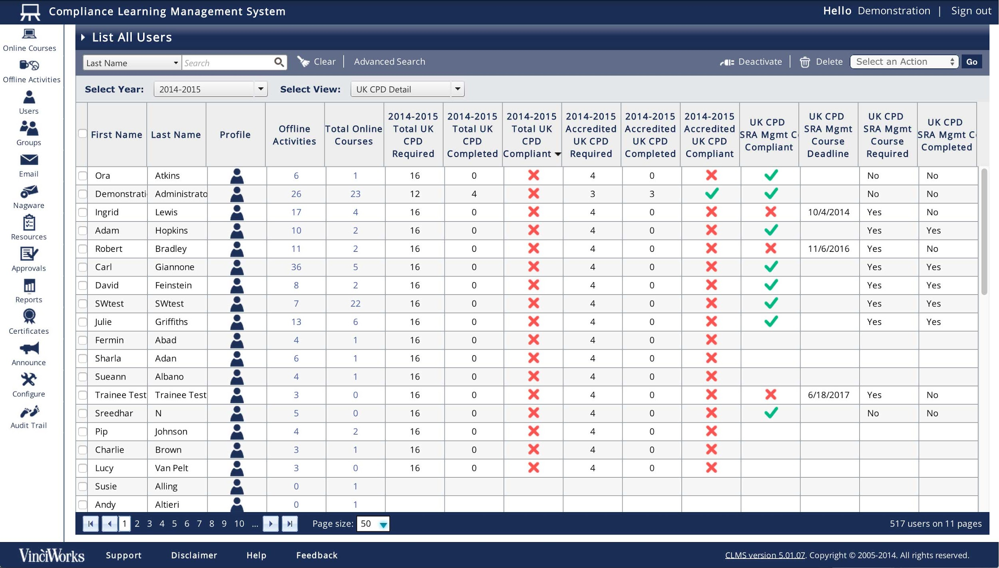
Compliance Learning Management System
Notes:
Example of a dashboard
- Flexible, modular

Slide 35
Compliance Learning Management System
HR Integration
Joiners automatically enrol in onboarding courses, leavers are automatically deactivated and any personal details remain in sync.
Fully automated
Users are automatically enrolled in the courses to maintain compliance. Nagware automates following up with non-compliant users
Customise everything
How you ever used an online service that sends emails you can't control? In the CLMS you have control over content and branding.
Audit trail and Reporting
Issue instant, robust reports on training progress to the board, or provide compliance documentation to a regulatory body.
Easy setup and operation
The CLMS includes only the features you need . Most firms are up and running in less than a month. Administrators receive one-on-one training.
Nagware
Stop chasing users. Automatically nags individuals with escalating warnings until they complete their mandatory requirements.
Notes:
Example of a dashboard
- Flexible, modular

